Slide 1
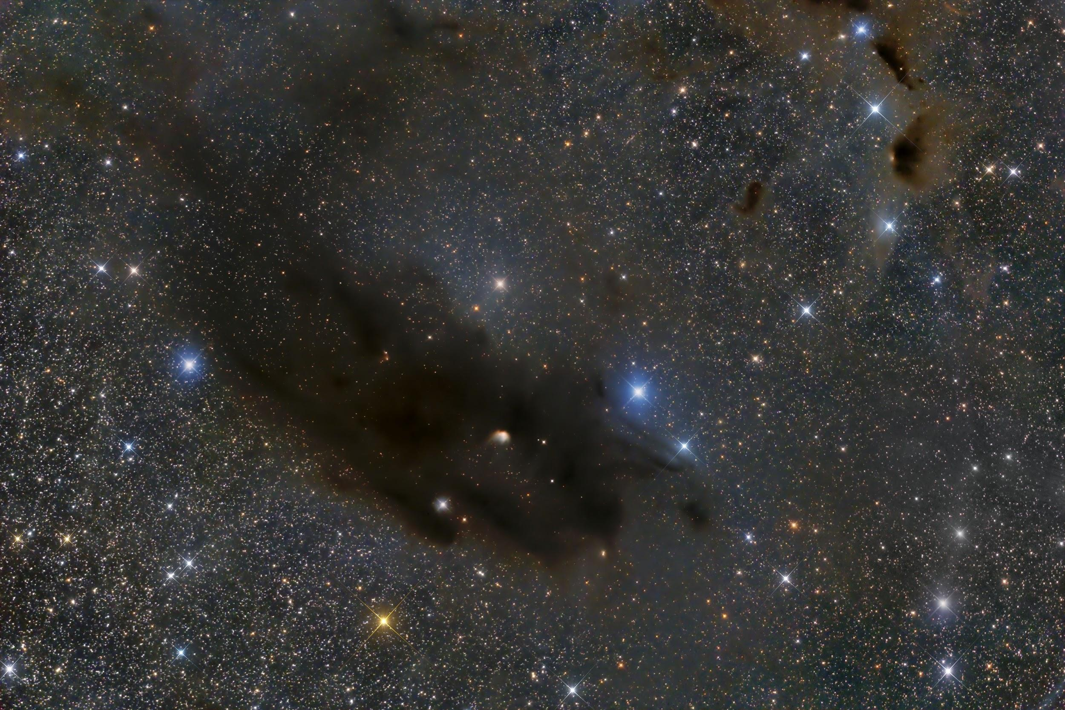
Isotope Ratios in L1521E
Jacob Magnusson
Maya Mancini
Jay Motka
Akash Satpathy
Image: Barnard 22 Dark Nebula in Taurus/Grand Mesa Observatory

Slide 2
Scientific Motivation
Isotopic abundance ratios gives information about galactic chemical structure and evolution in addition to planet formation and the synthesis of heavy elements.
C and O are created during stellar nucleosynthesis.
Thus, their isotopic ratio gives information on star formation (Langer & Penzias 1993).
It is interesting to look at carbon and oxygen based molecules like CO and its isotopic species.
Gravitationally bound, starless (dark) pre-stellar cores gives us information about initial conditions of star formation.
Notes:
Jay

Slide 3
Scientific Motivation and Goals
Lynds 1521E shows low chemical depletion of star material tracers.
Thus, it is still in the very early stages of star formation (Nagy et al. 2019).
Frequencies of (2-1) rotational transitions of CO and its isotopes are not far apart.
Pairs of these lines can be observed simultaneously! (It’s convenient.)
Thus, we present to look at (2-1) transition lines of CO and its isotopes from L1521E, situated in Taurus.
Goal: To calculate isotopic abundance ratios of C and O.
Notes:
Jay

Slide 4
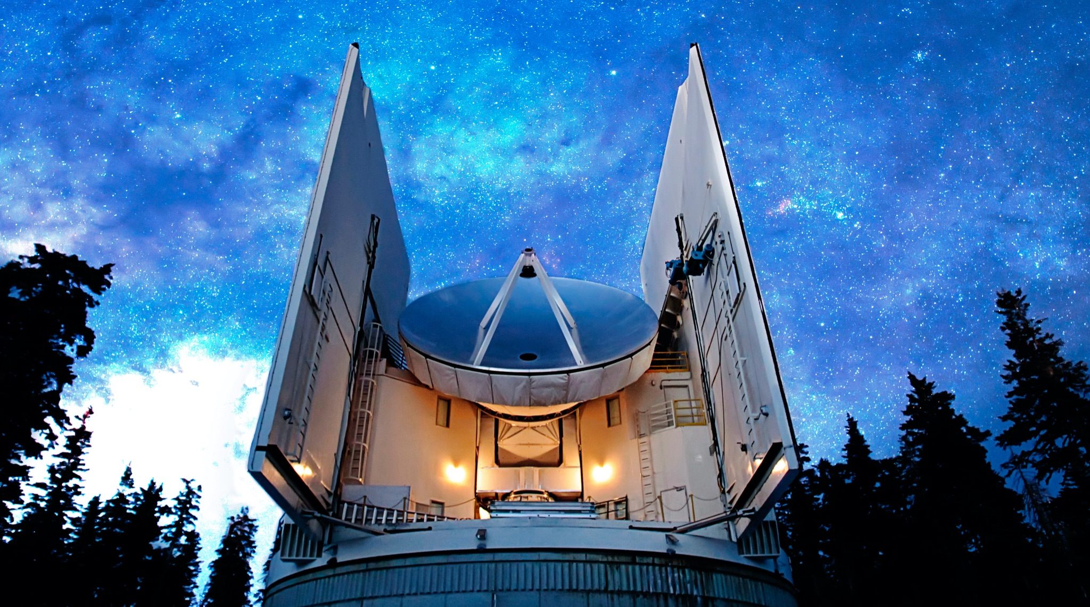
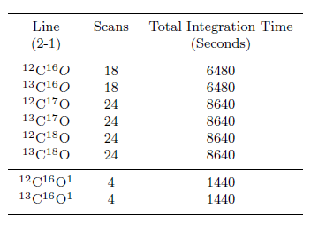
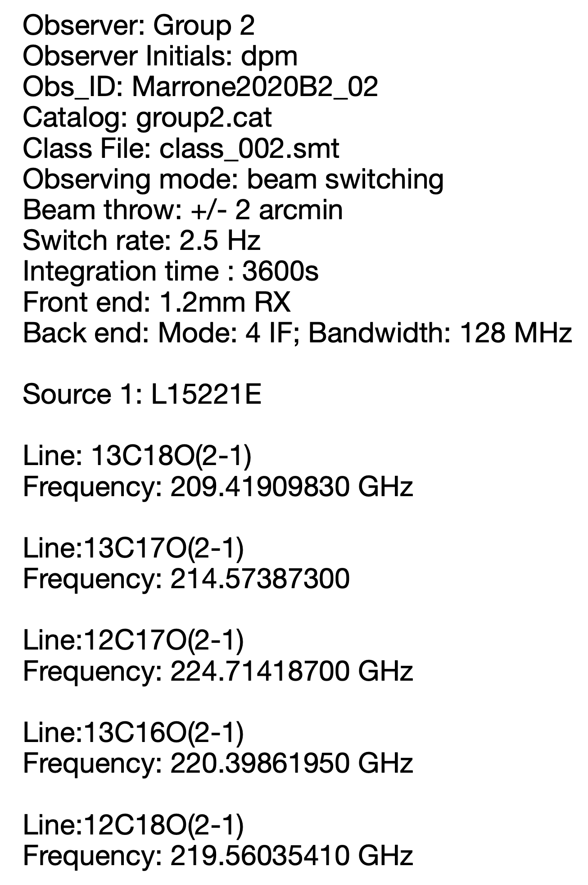
Observations
The SMT 1.3 mm Receiver was used for observations:
ALMA Band 6 (205 – 280 GHz)
Dual polarization, SBS
Typical Tsys@230GHz = 200-275 K
Best Tsys@230GHz = 130-160 K
Well suited to observe CO isotopes as they vary in the range 209 - 231 Hz.
Image 1: Total integration time for each of the lines
CO lines were chosen using Splatalogue, and coordinate information was found using SIMBAD.
Observing time span: 3 LST to 9 LST on the 6th of March, 2021
Mars was used as the bright continuum source for calibration
Most of the observations were done using beam switching method
Ryan Keenan provided some additional observations using the position switching method (on the 7th of March, 2021)
Image 2: Observing plan PDF
Image: Submillimeter Telescope/Arizona Radio Observatory
Notes:
Akash

Slide 5
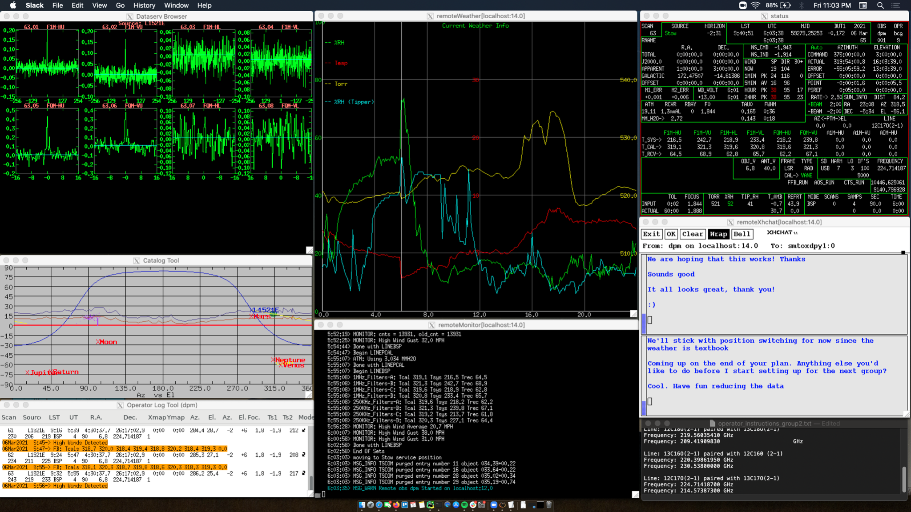
Observations
Notes:
Akash

Slide 6
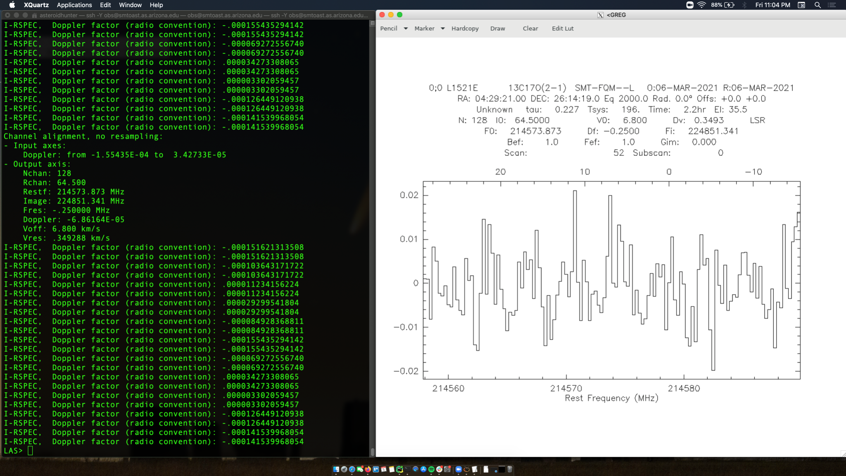
Observations
Notes:
Akash

Slide 7
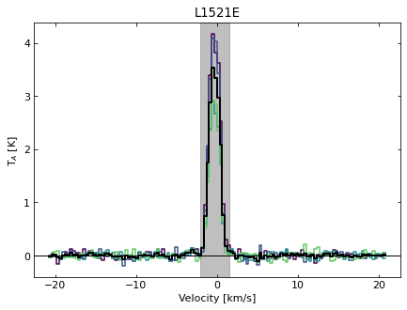
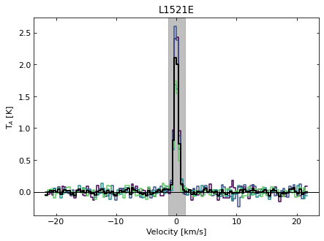
Measurements
¹²C¹⁶O
¹³C¹⁶O
Notes:
Akash

Slide 8
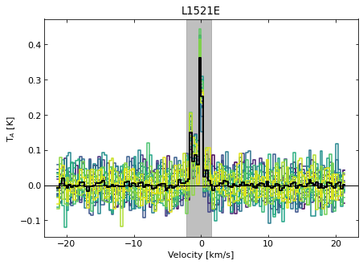
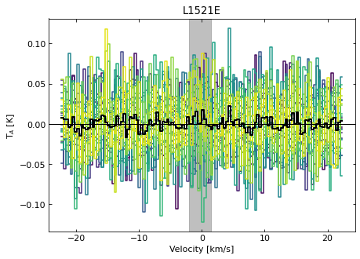
Measurements
¹²C¹⁷O
¹³C¹⁷O
Notes:
Akash

Slide 9
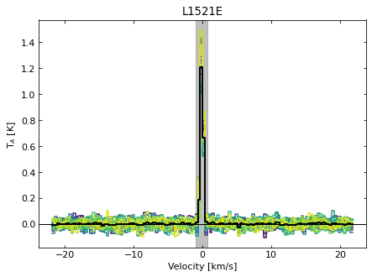
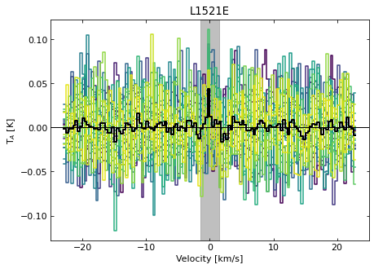
Measurements
¹²C¹⁸O
¹³C¹⁸O
Notes:
Akash

Slide 10
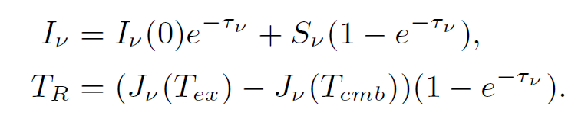
Theory
Going from integrated temperatures to abundance ratios is a complicated exercise in radiative transfer calculation.
Mangum and Shirley arrive at the solution to the radiative transfer equation in temperature units with a negligible background. We assume optically thin.
Notes:
Jacob Magnusson

Slide 11
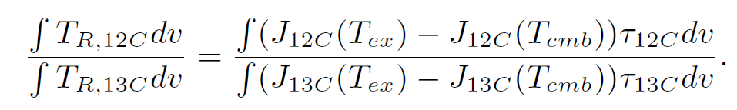
Theory
Difficult to motivate this now, but imagine taking the ratio of the integrated temperature of two different lines (The different isotopes)
Exponential from the previous slide was expanded in the optically thin limit, reducing it to a term linear on optical depth
Notes:
Jacob Magnusson

Slide 12
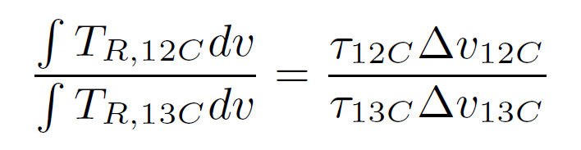
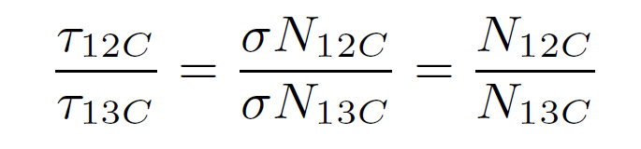
Theory
The optical depth will look like some column density times a cross section
The cross sections at their respective frequencies are approximated to be the same.
Notes:
Jacob Magnusson

Slide 13
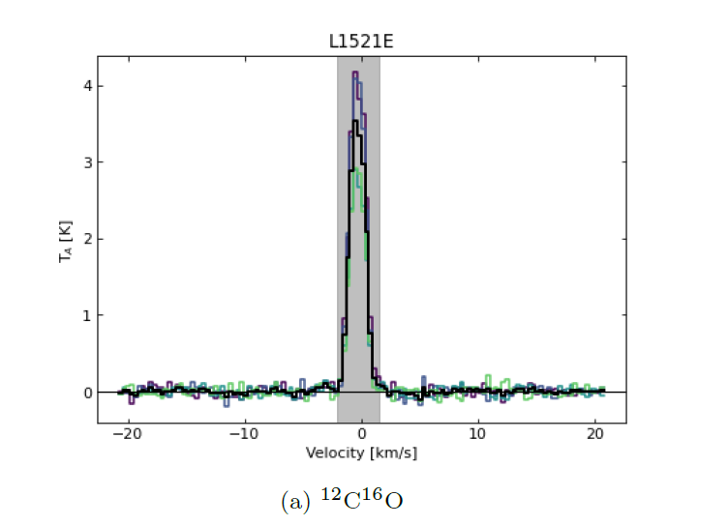
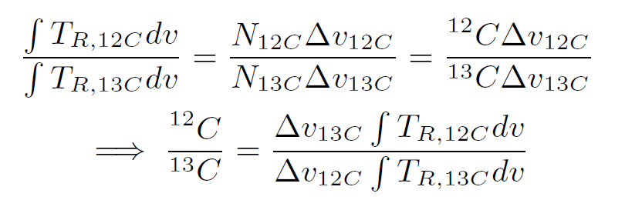
Theory
Approximating a rectangular line profile, the integral simplifies to the velocity width of our line.
Everything on the right hand side can be measured, so we can arrive at an abundance ratio.*
* No chemical fractionation (preferential reaction of lighter isotopes)
Notes:
Jacob Magnusson

Slide 14
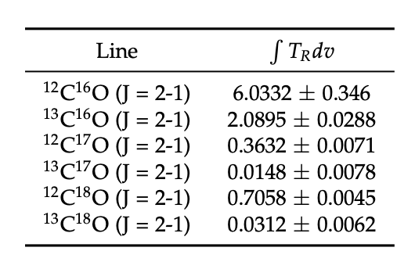
Data Analysis
Masking
Baseline Removal
- Degree 5 Polynomial
Averaging
- Weighted using System Temp
Integration
Notes:
Maya Mancini

Slide 15
Data Analysis
We used the CHAOS pipeline to process our scans
In doing so, we produced the following integrated antenna temperatures for each line of the CO species we observed
These values were then used to directly calculate the ratios 12C/13C, 16O/17O, and 16O/18O
Notes:
Maya Mancini

Slide 16
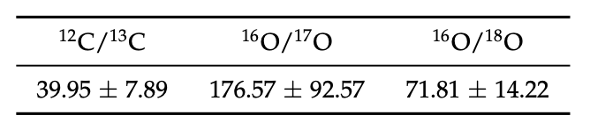
Results
For calculation, we utilized our working equation derived in the theory section
We made sure to use the combination of isotopologues that minimized the standard deviation
In doing so, we ended up not combining CO species with ¹²C to find our Oxygen ratios, nor did we use ¹²C¹⁶0 for any calculation because it was not assumed to be optically thin
Notes:
Maya Mancini

Slide 17
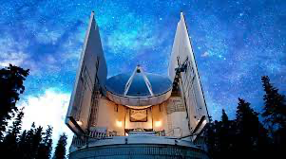
Results
We compared our ratios to known values in the local ISM (Langer & Penzias 1993).
We also compared our ¹²C/¹³C ratio to one already observed in L1521E which was ¹²C/¹³C = 58.8 ± 3.7 (Ikeda et al. 2002).
Our values were in the expected range for the ISM.
Our measured value of ¹²C/¹³C is lesser than the observed value in Ikeda et al. (2002) by about 31%.
Might be due to poor SNR (about 5.1) of ¹³C¹⁸O line and along with very generous theoretical assumptions.
Very large error in the measurement of ¹⁶O/¹⁷O is due to extremely poor SNR of 1.9 for ¹³C¹⁷O.
Notes:
Maya

Slide 18
Conclusion and Discussion
While our calculated values were within the expected range, there were deviations that were not insignificant by any means.
This relative error can be attributed to a number of factors:
Our many theoretical assumptions
Limited time
Limitations of the SMT 1.3mm receiver at frequencies near 200 GHz
Poor SNR
Notes:
Maya/Everyone

Slide 19
Future Prospects
More precise data is needed the most.
Thus, more integration time would give us precise measurements.
Rectangular line profile that we took in the theoretical calculations can be further modified to fit the Gaussian velocity profile.
CHAOS is being actively developed, and doesn’t have all needed features implemented yet. We believe line profile fitting would be incredibly useful to either implement into CHAOS or pair with CHAOS.
Weighted temperature integrations to better standardize a reference column density.
Notes:
Jay

Slide 20
References
Ikeda M., Hirota T., Yamamoto S., 2002, ApJ, 575, 250
Langer W. D., Penzias A. A., 1993, ApJ, 408, 539
Mangum J. G., Shirley Y. L., 2015, PASP, 127, 266
Nagy Z., Spezzano S., Caselli P., Vasyunin A., Tafalla M., Biz-zocchi L., Prudenzano D., Redaelli E., 2019, A&A, 630, A136

